Slide 1

FOLLOW THE DINOSAURS

Slide 2
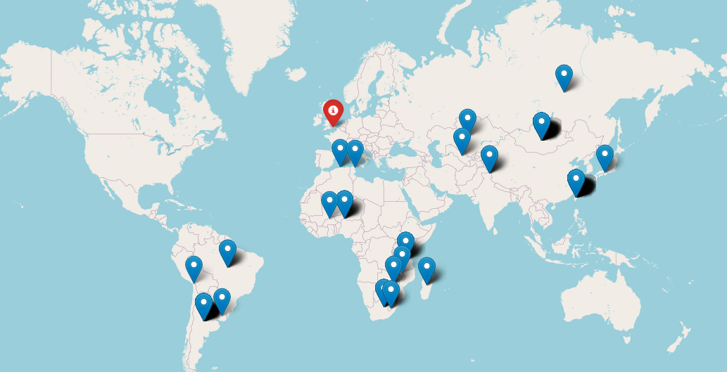

Slide 3
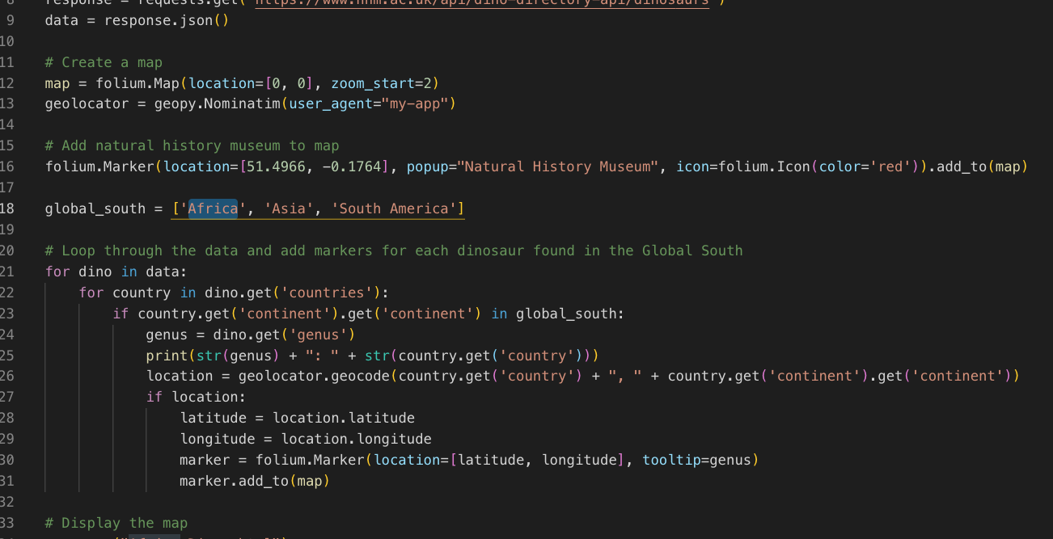

Slide 4
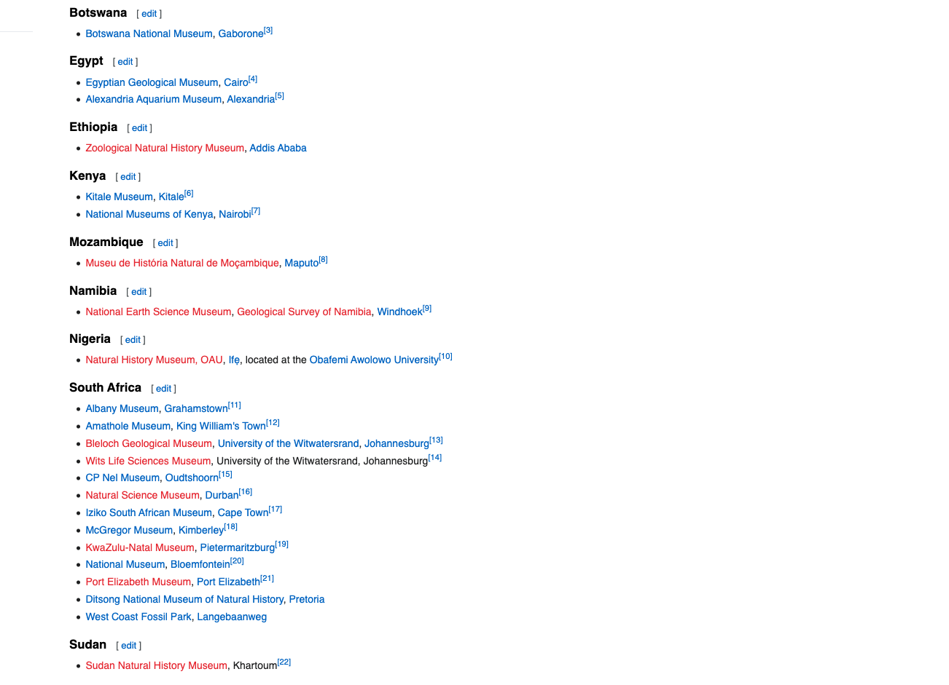
FUTURE WORK- ADD MORE MUSEUMS!

Slide 5
FUTURE WORK- THE JOURNEY BETWEEN
Get data on places these dinosaurs have been in between arriving at the museum and being discovered. Some directly came here but others may have gone elsewhere

Slide 6
Git Repo
https://github.com/PallaviRishi/FossilMap

